Slide 1

Matthew Chun
Carl Ross
Tracy Tran
Carson Wilk
Matthew Chun
Carl Ross
Tracy Tran
Carson Wilk

Slide 2
Overall Problem

Slide 3
Motivation
People want to…
- Be more environmentally friendly¹
85% expressing a desire to own an eco-friendly home
- Save money²
21% of income on housing-related costs
http://www.realtor.com/news/real-estate-news/most-americans-want-eco-friendly-homes¹
http://www.fool.com/retirement/general/2016/02/15/heres-how-much-the-average-american-family-spend-2.aspx²
Notes:
The easiest step towards achieving both goals is through decreasing utility consumption.

Slide 4
Problem
Barriers are…
- Delayed feedback
Absence of personal accountability
- Lack of conscious thought about usage
- Prioritized convenience

Slide 5
Design Research

Slide 6
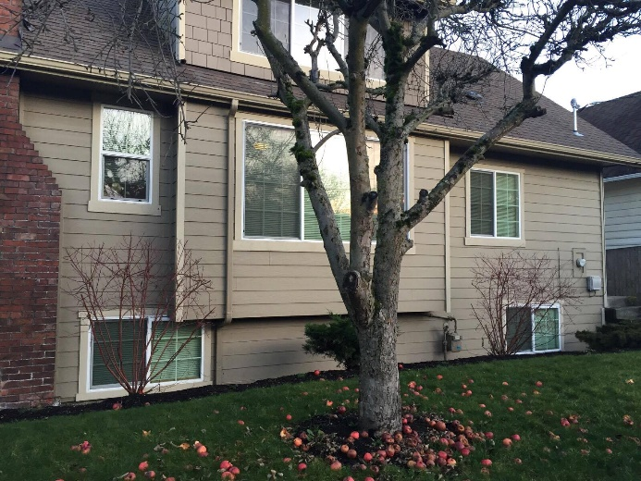
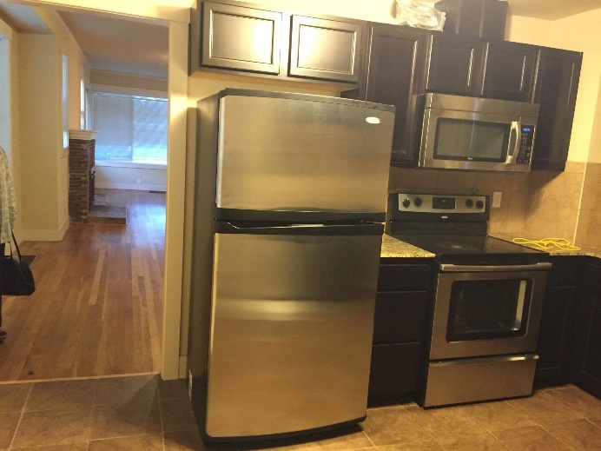
Methodology
6 contextual inquiries
in home
6 diary studies
every 4 hours over a 24-hour period

Slide 7



Participants
Aged 21-26
Financially independent
College students and young professionals
Range of gender and household size

Slide 8
“The room was too hot but I was in bed and the heater was across the room... so I opened the window instead”

Slide 9
“I always forget to turn off the hallway light”

Slide 10
“I know I should turn off the light, but knowing 7 other people will pay for it makes it not a big deal”

Slide 11
Usage Cycle
Analyze information
Take action
Receive feedback

Slide 12
Tasks

Slide 13
Tasks
- Maintain a comfortable temperature
- Control lights remotely
- Compare your usage
- Understand your impact
- Hold everyone accountable
- Pay what you use

Slide 14
Design Sketches

Slide 15
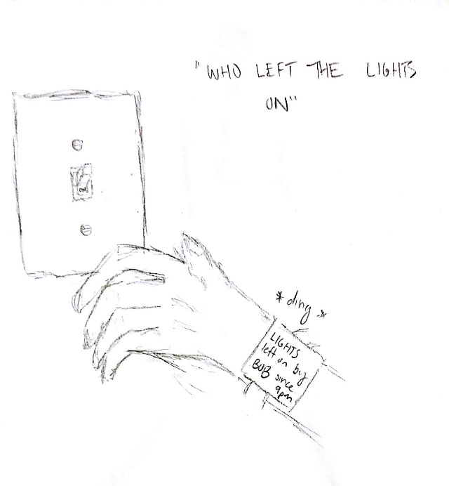
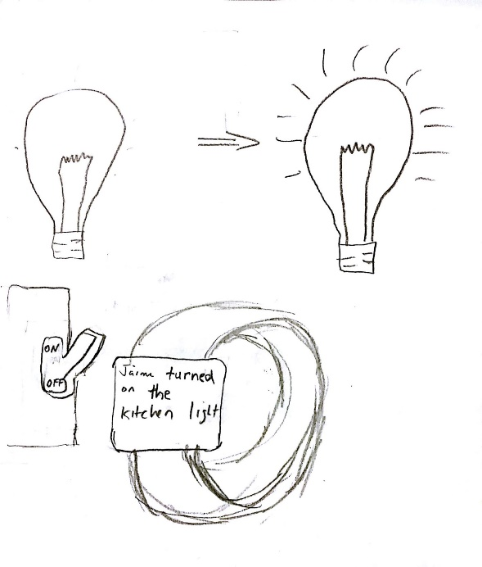
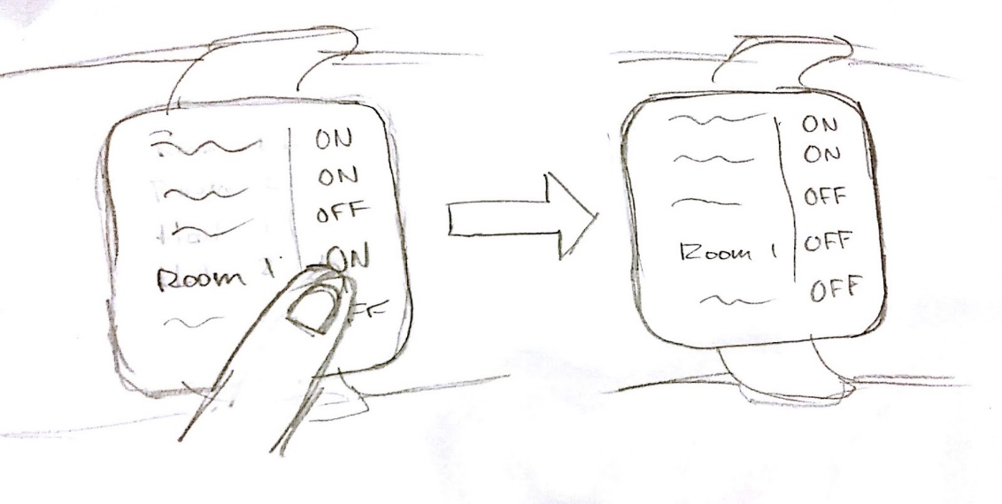
Design 1 - Wearable
Hold everyone accountable
Control lights remotely
Pay what you use

Slide 16
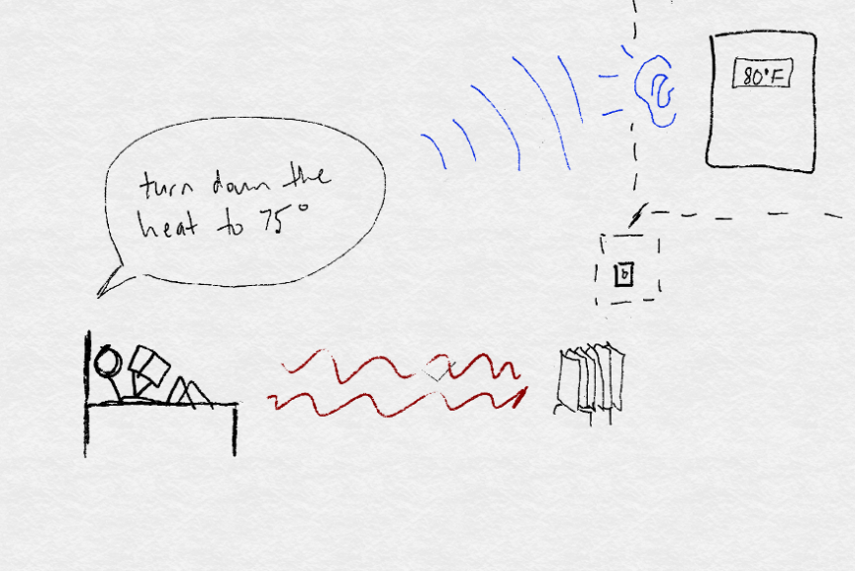
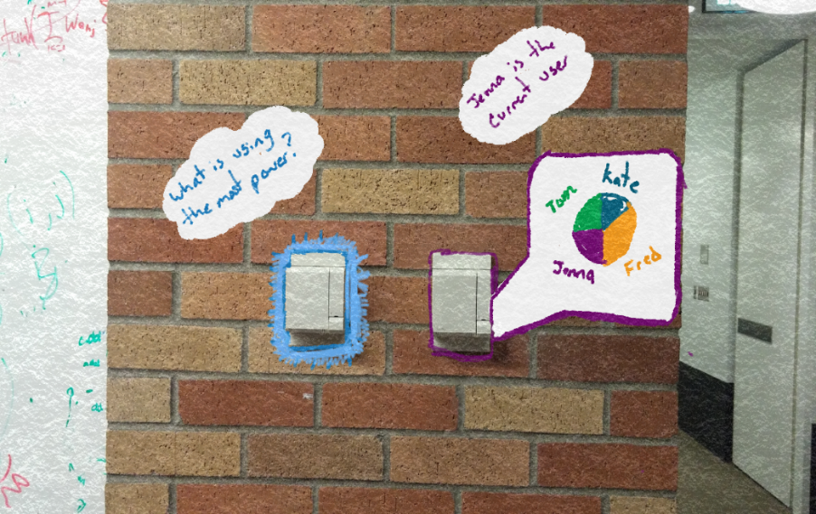
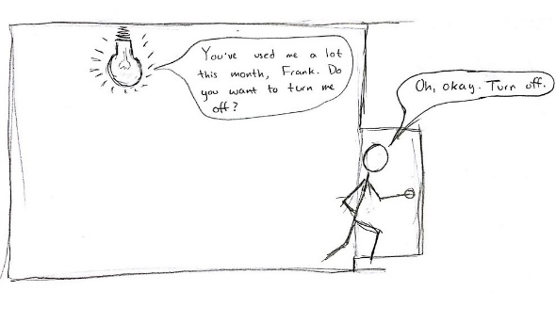
Design 2 – On Appliance
Maintain comfortable temperature
Compare usage
Control lights remotely

Slide 17
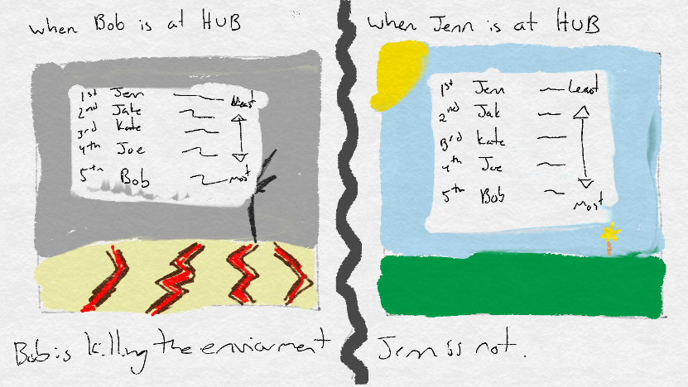
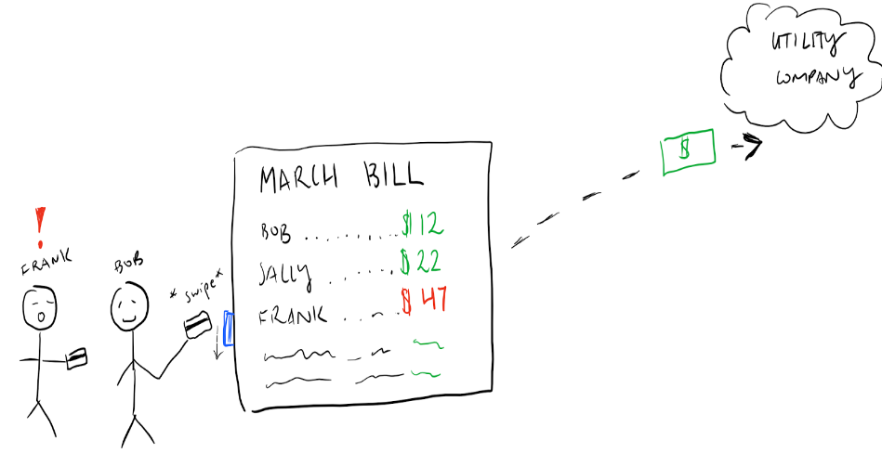
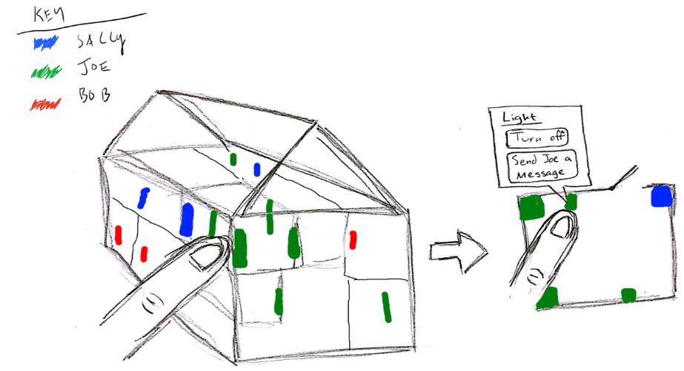
Design 3 - Hub
Compare your usage
Pay what you use
Hold everyone accountable

Slide 18
Selected Design Storyboards

Slide 19
Selected Design
- Goal: increase efficiency in every step
of the usage cycle
Interactive, informational hub paired with conveniently-controlled appliances
Analyze information
Take action
Receive feedback

Slide 20
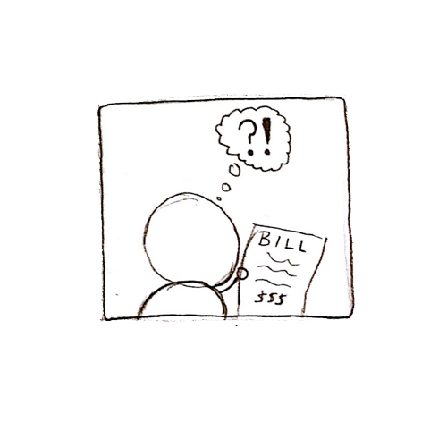
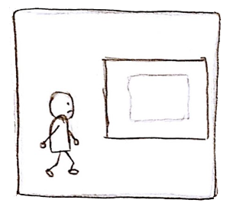
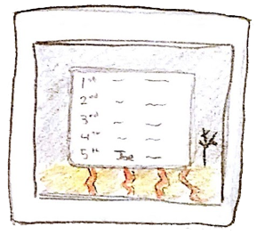
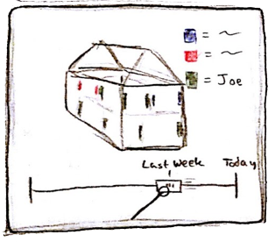
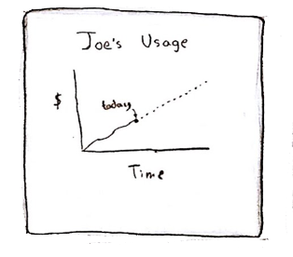
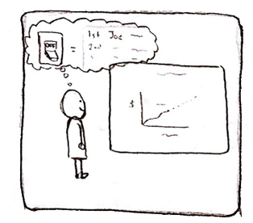
Storyboard 1 - Information
Joe is concerned about why his utility is so high.
He walks to the hub to find out why.
Joe sees a sad image and himself with the worst ranking!
Joe sees he leaves certain lights on via the 4d model.
He also looks at a chart showing past and projected usage.
Joe now understands what to change in the future!

Slide 21
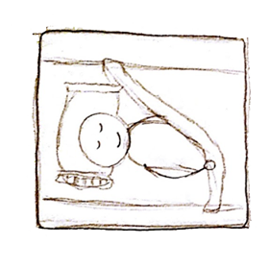
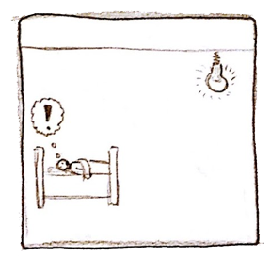
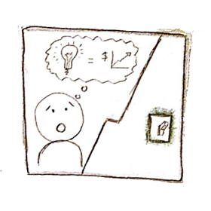
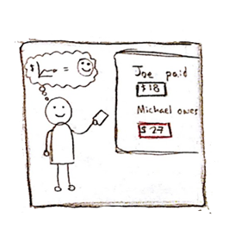
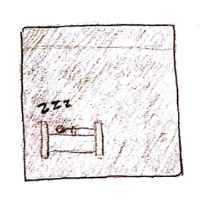
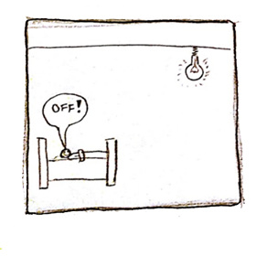
Storyboard 2 - Action
Joe is about to go to bed.
He realizes the lights are still on.
He notices the color, which shows he is the one using it.
Joe tells the light to turn off.
The light turns off and Joe can sleep happily.
At the end of the month, Joe pays less because he used less!

Slide 22
Summary

Slide 23
Summary
An effective design will increase…
- Frequency of feedback
Sense of individual responsibility
- Awareness of usage
- Convenience of efficiency

